Slide 1


SPESS GSA End of Year Meeting
4/14/2023

Slide 2
Year Recap
Improved communication, connection, and collaboration
Ongoing projects
Productive outreach
Tours
Soft Skills training experience

Slide 3

Plant Symposium
Theme ?
Committee ?
Organization?
Sponsors ?
Opportunities

Slide 4
New Classes Offered
AGRO 8901 – Predictive Breeding (Dr. Roberto Fritsche Neto)
AGRO 8902 – Precision Ag (Dr. Tri Setyano)
AGRO 4091 - Linear Modeling and Statistics in Quantitative Genetics (Dr. Noah DeWitt)
EXST 4142 - Introduction to R and Statistical Data Mining
EXST 7142 - Statistical Data Mining

Slide 5


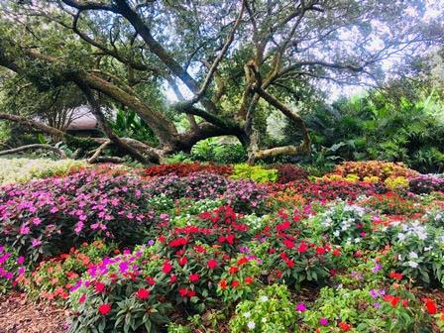
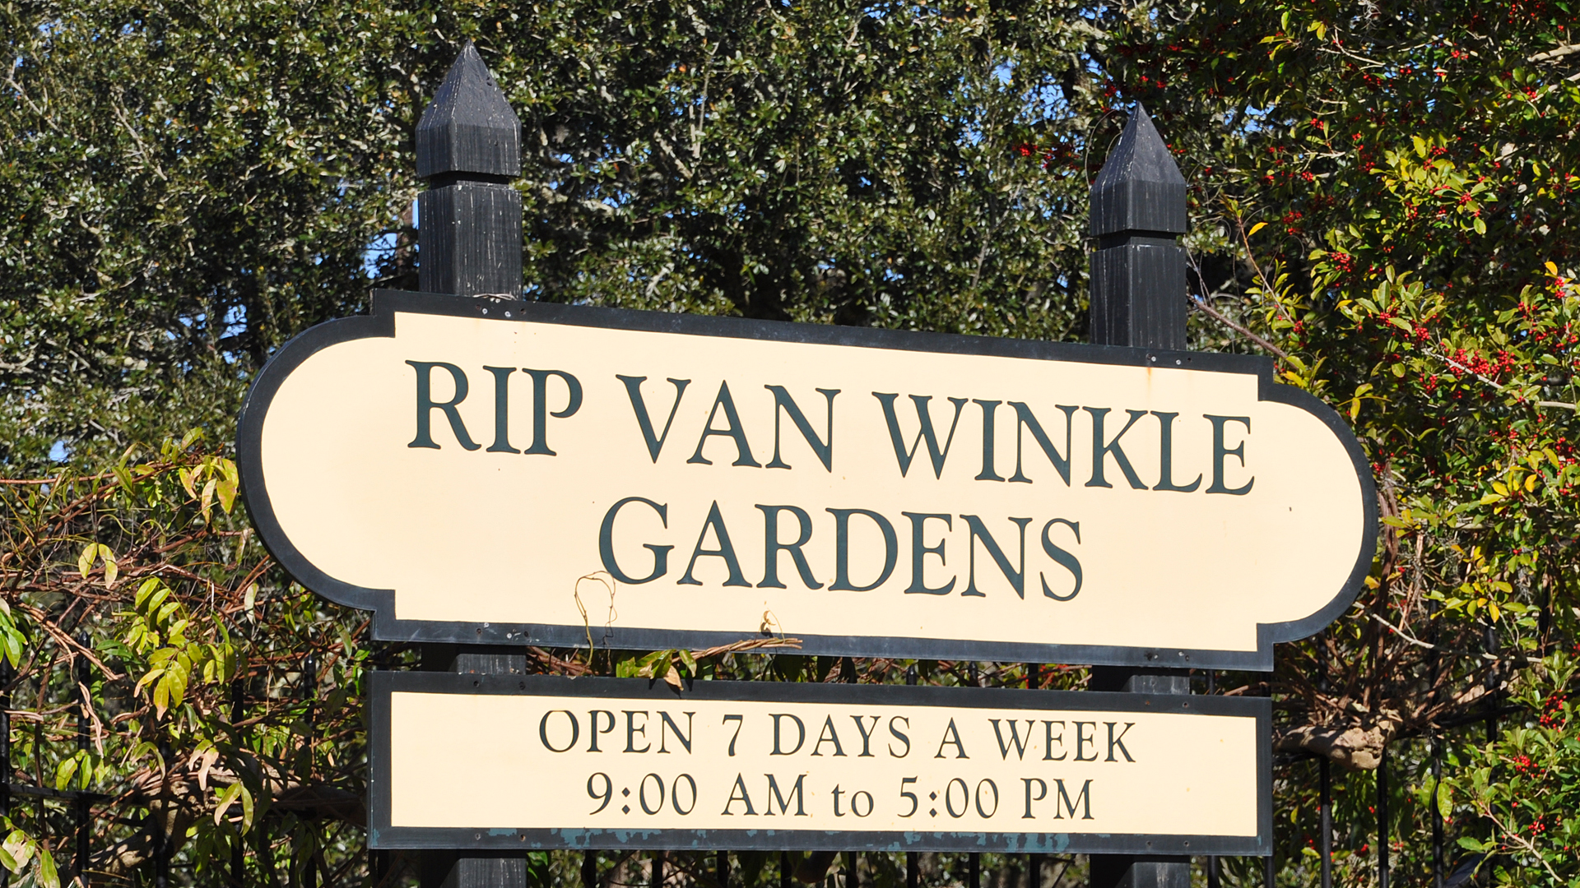
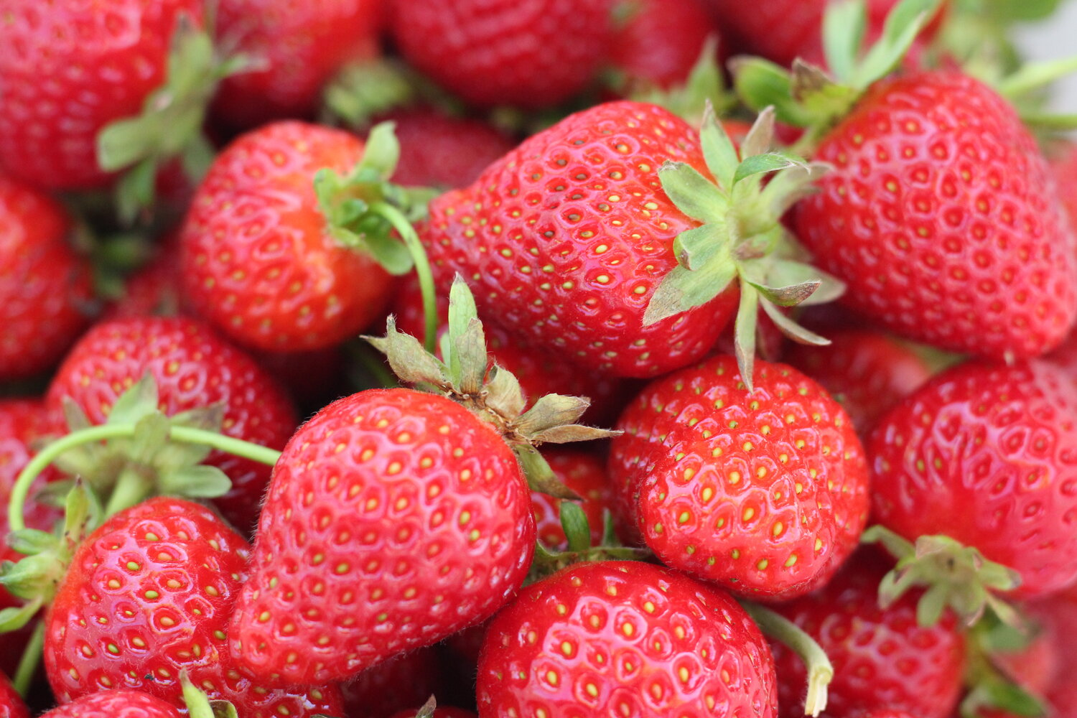
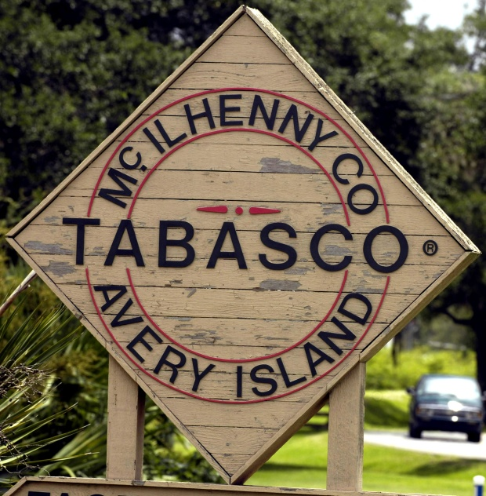
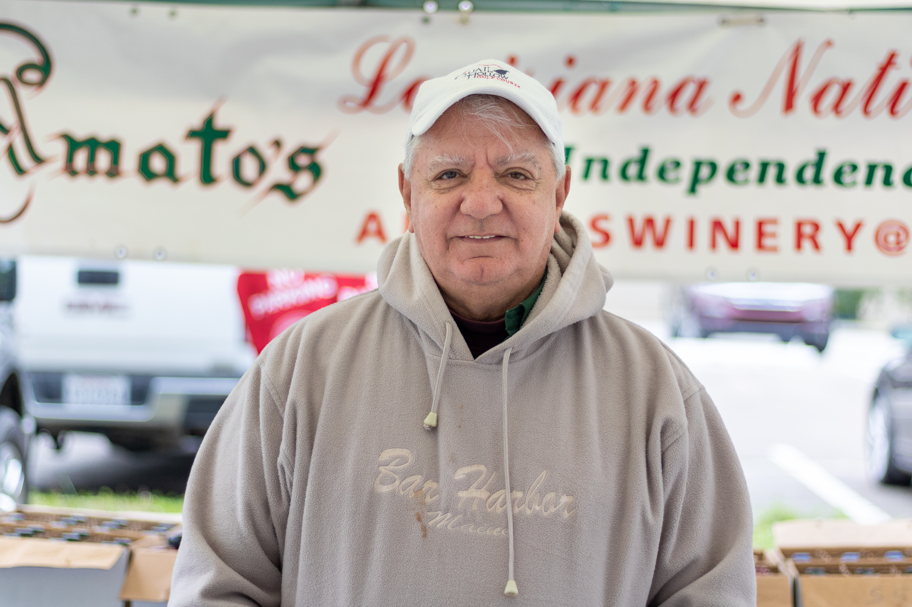



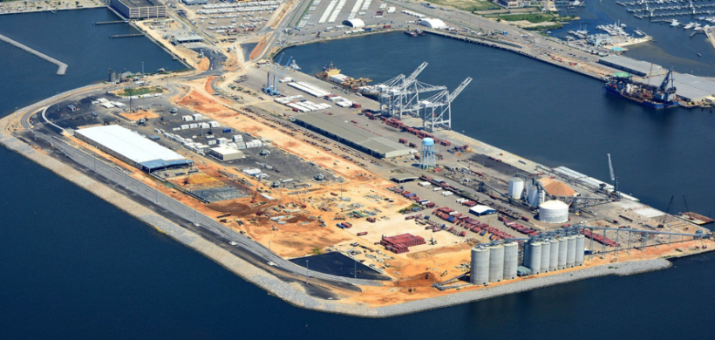


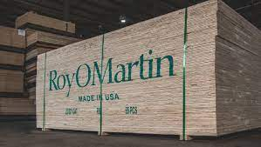

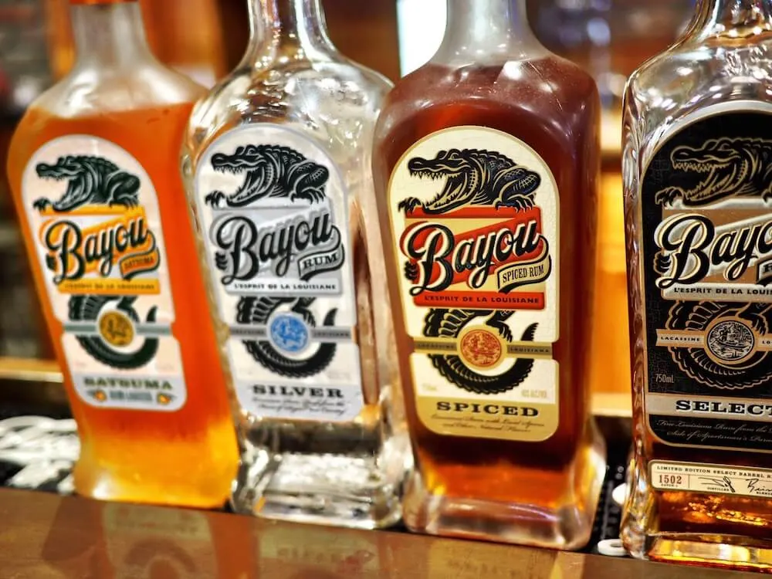
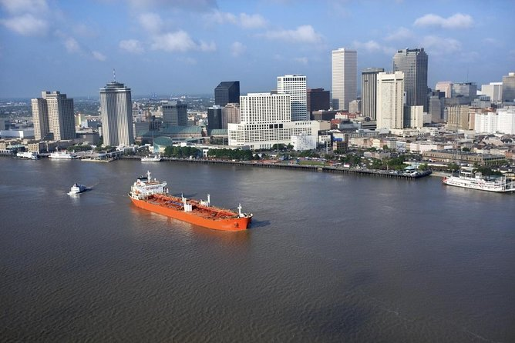

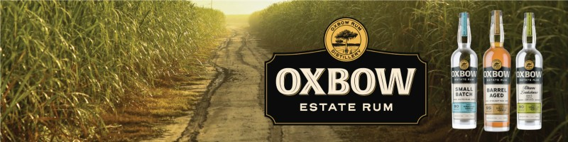

Plans for the Future!

Slide 6
Feedback/Open Forum
Goals/expectations

Slide 7
Elections
President

Slide 8
Elections
Vice President

Slide 9
Elections
Treasurer

Slide 10
Elections
Secretary

Slide 11
Elections
Social Media Coordinator

Slide 12
Elections
Outreach Coordinator

Slide 13
Graduate Student Association - Outreach coordinator
Goal for the position:
Gather the attention of students (graduate / interested undergraduate) students to become more involved with GSA
Connect graduate students across different fields of study (horticulture, entomology, agronomy, etc.)
Plan events and create a graduate community
Potential activities in the future:
Connect with undergraduate students to discuss the opportunities of graduate school
Graduate students meet at local restaurants / breweries
Gives us chances to meet each other, and take a break from rigorous research / classes

Slide 14
Crawfish Boil and Rice Station Tour
Saturday April 14, 3:00 PM – Hill Farm
Friday April 21, 8:00 AM – H. Rouse Caffey Rice Research Station

